Slide 1
Deriving discharge using USGS stage
Supervisor: Dr. Bong Chul Seo
Presenter: Sujan Maharjan

Slide 2
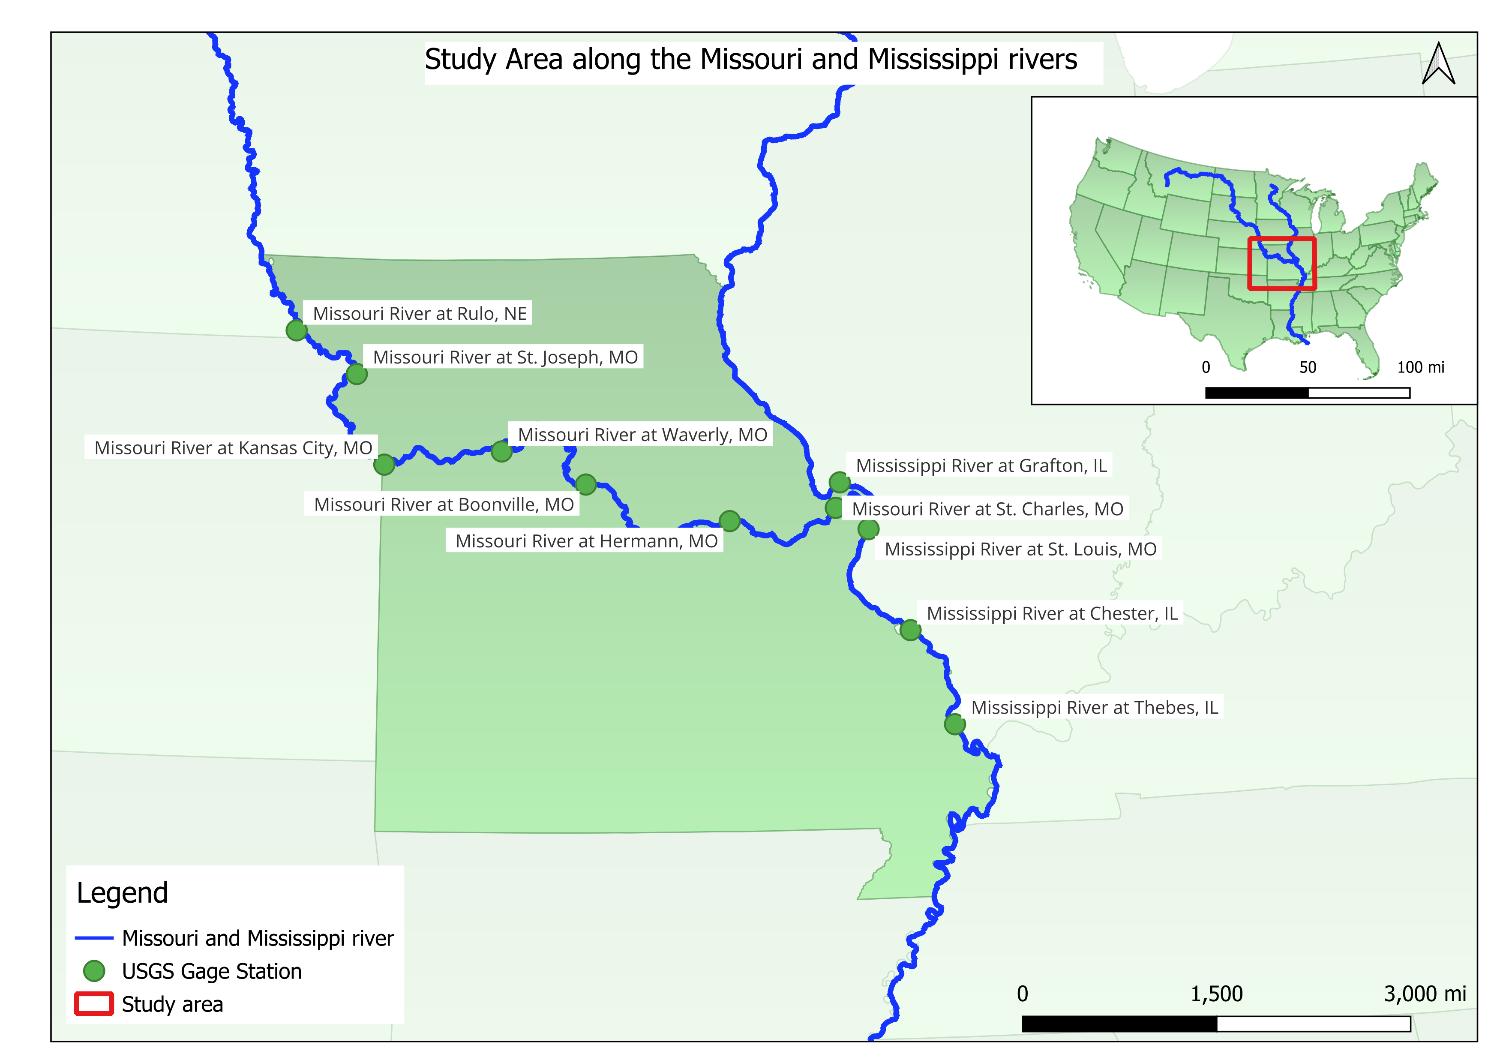
Study area

Slide 3
Shift
Correction applied to stage-discharge relation, or rating, to compensate for variation in the rating
Shifts are temporary
Every Gage has their own shift, which are added to the gage heights
Caused due to man-made or natural changes in the river geometry

Slide 4
Parameters tree
When backwater effect is minimum to none
Shifted gage height
(G_{sH})
USGS Gage height at Thebes (GH_{T})
Rating Table
Rated Discharge (Q_{R})
Calculated USGS Discharge (Q_{M})
Sum
Shift (s)
Product
Rated Fall (F_{r})
Difference
Discharge Factor (Fm/Fr)
Datum of Gage +299.70 ft
Measured Fall (F_{m})
USGS Gage height at Cape Girardeau (GH_{C})
Datum of Gage +304.27 ft

Slide 5
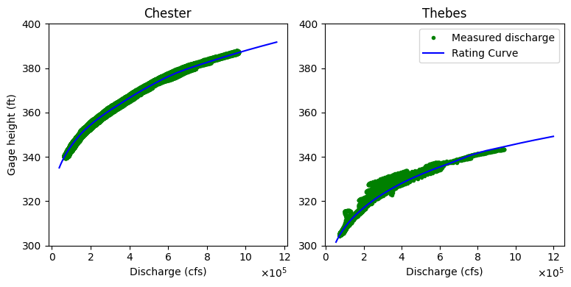
Station of interest: Thebes
Has a high backwater effect
Uses slope rating method using the Gage height at the Cape Girardeau

Slide 6
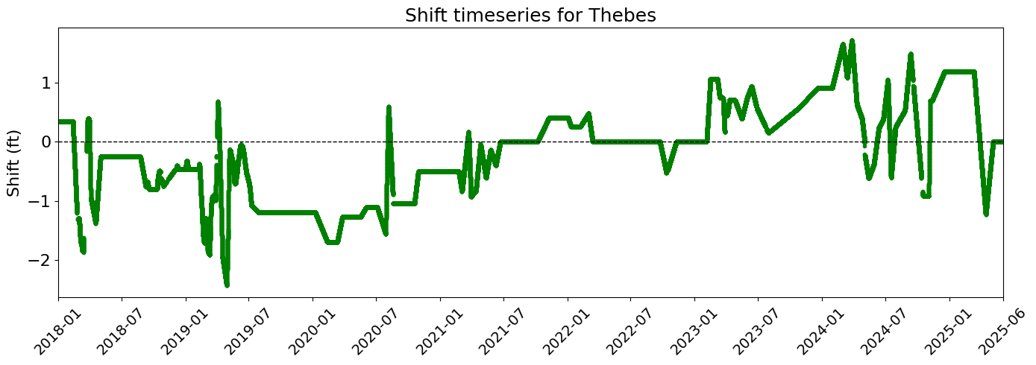
Data available
Rating curve from 2017-02-21
Rating curve dated 2025-06-18
Shift at Thebes in 30-minute interval
Gage height at Cape Girardeau and Thebes

Slide 7
Methods
3 different types of extended rating table have been used to obtain the USGS discharge using the USGS stages
[METHOD 1]: Using 2017-02-21 extended rating table
[METHOD 2]: Using 2025-06-18 rating table from USGS website including the given shift
[METHOD 3]: Using 2025-06-18 rating table from USGS website not including the given shift
*It is brought to attention that the shift will be applied to gages in all methods. The shift being applied in Method 2 is to the rating curve in addition to the gages.

Slide 8
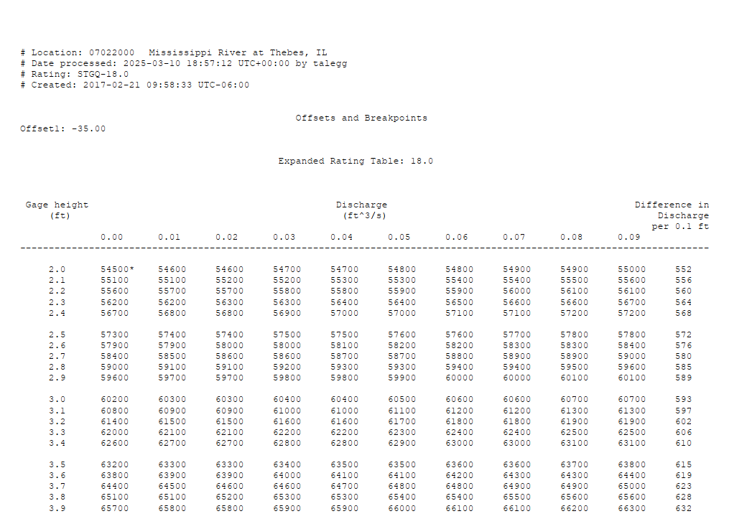
Method 1
[METHOD 1]: Using
2017-02-21 extended rating table

Slide 9
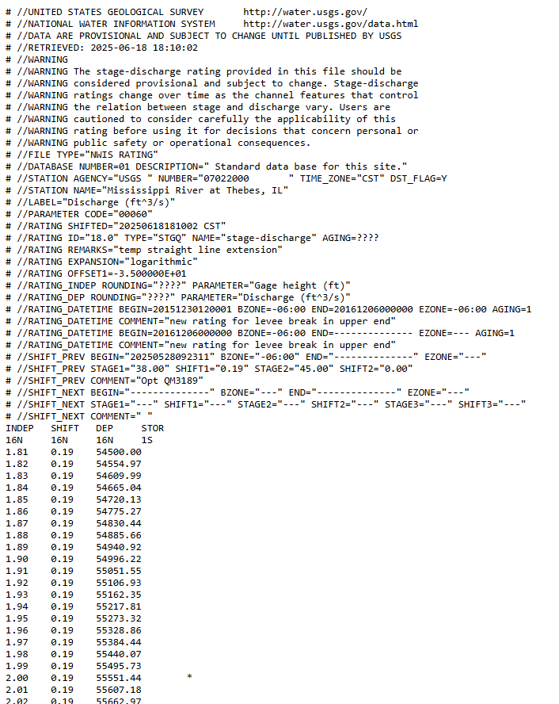
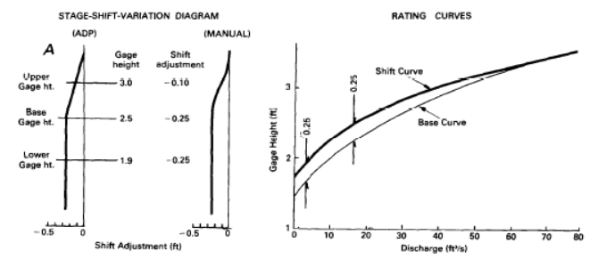
Method 2
INDEP (ft) | SHIFT (ft) | Discharge (CFS) | Shifted Depth (ft)
1.81 | 0.19 | 54500.00 | 1.62
1.82 | 0.19 | 54554.97 | 1.63
1.83 | 0.19 | 54609.99 | 1.64
1.84 | 0.19 | 54665.04 | 1.65
1.85 | 0.19 | 54720.13 | 1.66
1.86 | 0.19 | 54775.27 | 1.67
1.87 | 0.19 | 54830.44 | 1.68
1.88 | 0.19 | 54885.66 | 1.69
1.89 | 0.19 | 54940.92 | 1.7
1.9 | 0.19 | 54996.22 | 1.71
1.91 | 0.19 | 55051.55 | 1.72
1.92 | 0.19 | 55106.93 | 1.73
1.93 | 0.19 | 55162.35 | 1.74
1.94 | 0.19 | 55217.81 | 1.75
1.95 | 0.19 | 55273.32 | 1.76
1.96 | 0.19 | 55328.86 | 1.77
1.97 | 0.19 | 55384.44 | 1.78
1.98 | 0.19 | 55440.07 | 1.79
[METHOD 2]: Using
2025-06-18 rating table from USGS website including shift

Slide 10
Method 3
INDEP (ft) | SHIFT (ft) | Discharge (CFS)
1.81 | 0.19 | 54500.00
1.82 | 0.19 | 54554.97
1.83 | 0.19 | 54609.99
1.84 | 0.19 | 54665.04
1.85 | 0.19 | 54720.13
1.86 | 0.19 | 54775.27
1.87 | 0.19 | 54830.44
1.88 | 0.19 | 54885.66
1.89 | 0.19 | 54940.92
1.9 | 0.19 | 54996.22
1.91 | 0.19 | 55051.55
1.92 | 0.19 | 55106.93
1.93 | 0.19 | 55162.35
1.94 | 0.19 | 55217.81
1.95 | 0.19 | 55273.32
1.96 | 0.19 | 55328.86
1.97 | 0.19 | 55384.44
1.98 | 0.19 | 55440.07
[METHOD 3]: Using 2025-06-18
rating table from USGS website not including shift

Slide 11
Results
SN | Method | Mean average percentage error (%) | Normalized Root Mean Squared Error | Kling-Gupta Efficiency
1 | Method 1 | 0.69 | 0.312 | 0.9937
2 | Method 2 | 1.98 | 0.593 | 0.9812
3 | Method 3 | 0.79 | 0.277 | 0.9934

Slide 12
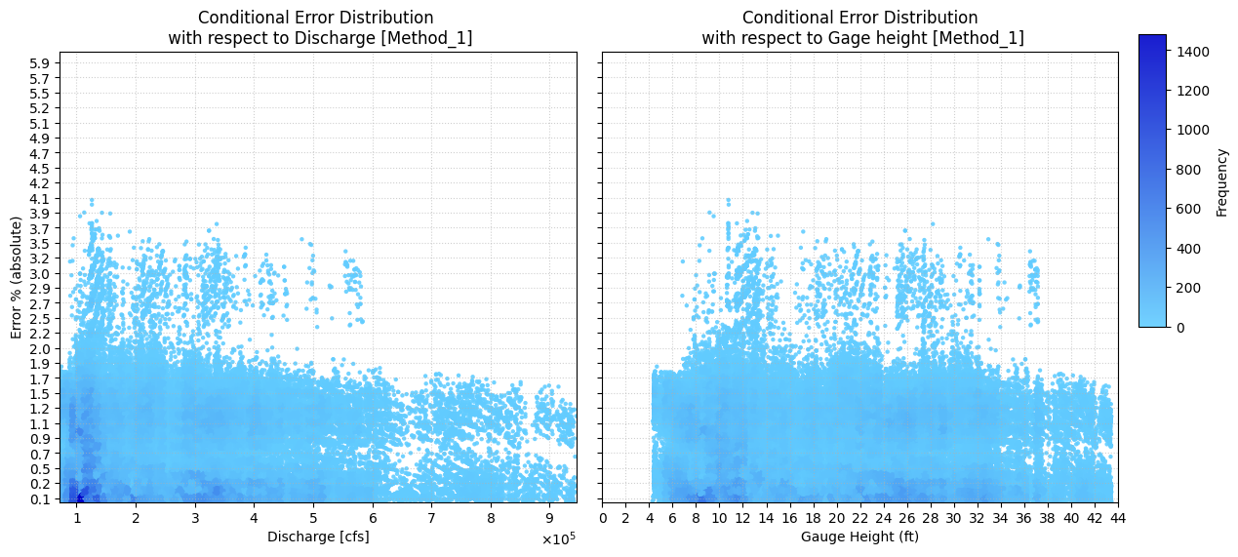
Method 1 Results

Slide 13
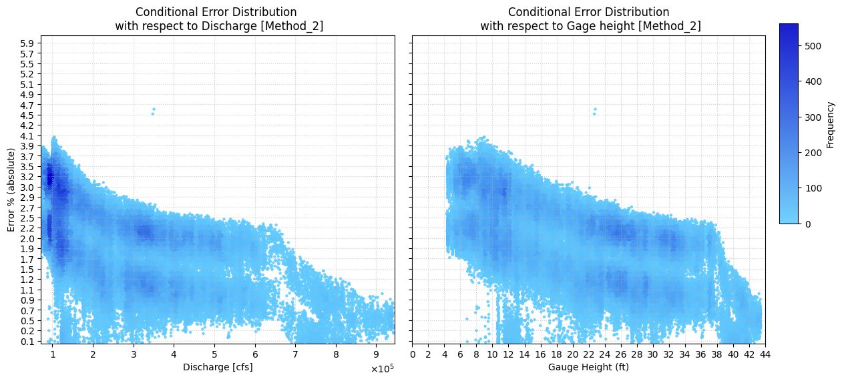
Method 2 Results

Slide 14
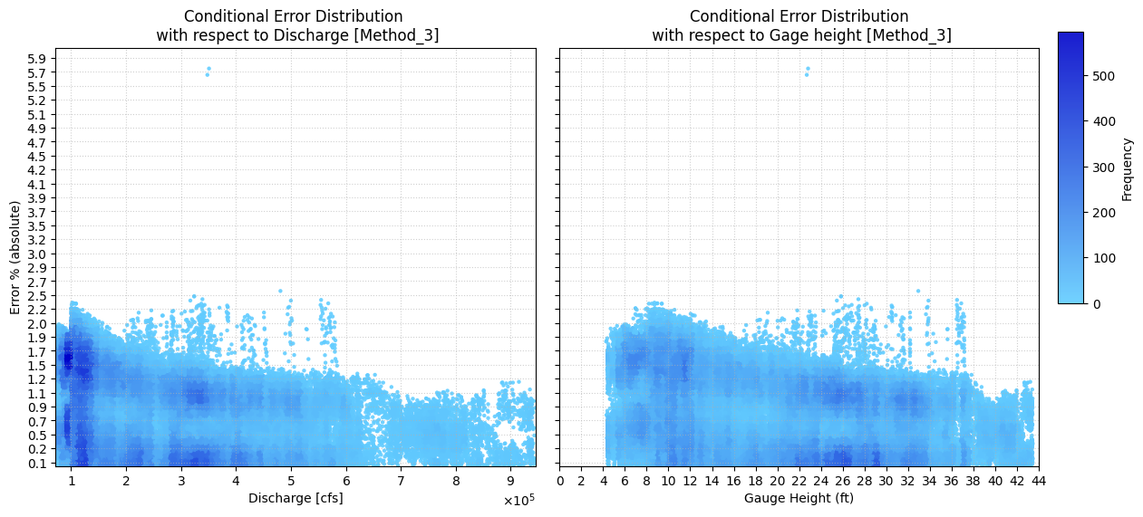
Method 3 Results

Slide 15
Queries
Which rating curve is the base rating curve for the given shifts (2017/2025)?
After a rating curve has been shifted and USGS publishes the new rating curve, does the shift apply to the new rating curve or still to the previous one?

